Slide 1
Data wrangling and modeling
Team Flightify 2.0

Slide 2
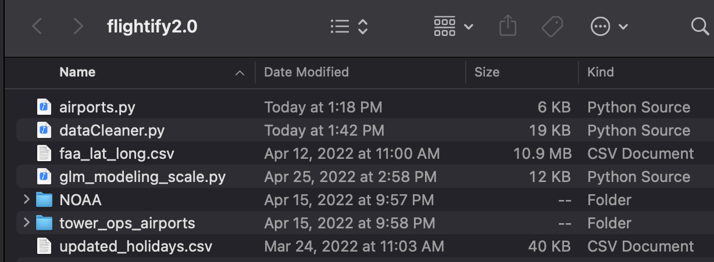
Pre steps
Make sure the following file structure exists

Slide 3
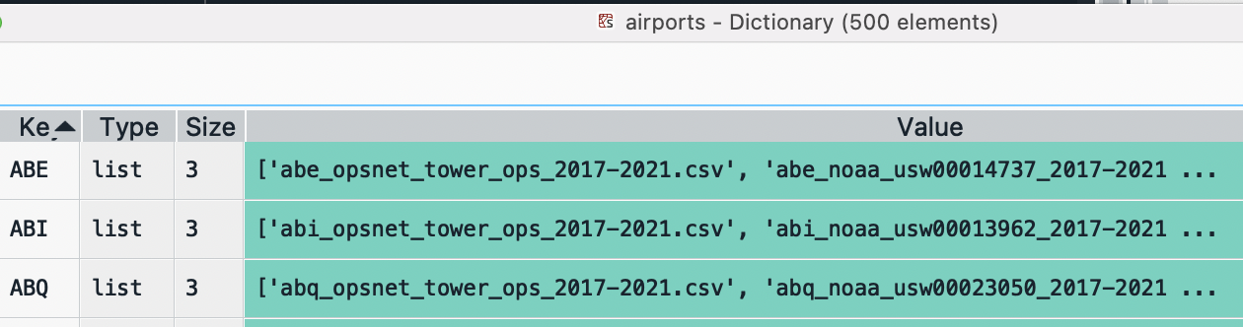
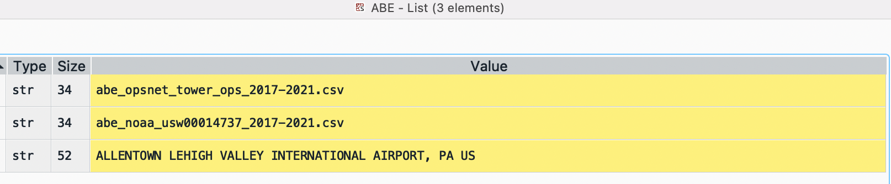
airports.py
airports.py – Houses the sorted dictionary for the 500 airports
LOC: [tower_opsnet_csv, noaa_csv, airport name]

Slide 4
Steps for airports.py
Update the “﻿tower_ops_path” variable to point to the correct ﻿folder were all the Tower OpsNet csv files live
Update the “﻿﻿noaa_path” variable to point to the correct ﻿folder were all the NOAA weather csv files live

Slide 5
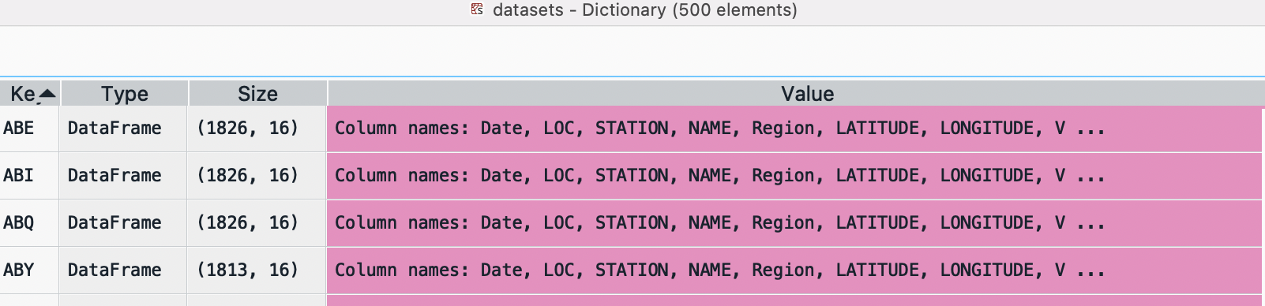
dataCleaner.py
dataCleaner.py iteratively performs the required ETL transformations for 500 airports.
dataCleaner.py outputs as a pickled dictionary the 500 cleaned pandas DataFrames.
The output dictionary is called datasets (on GitHub as datasets.zip)

Slide 6
Steps for dataCleaner.py
Update line 16 to set the appropriate path where the main project resides

Slide 7
Modeling
Performs Generalized Linear Poisson Regression on 496 airports
Outputs as a pickled dictionary the model_dict

